Slide 1

SPOTIFY ANALYSIS: SQL PROJECT
By Babitha Ravindra

Slide 2
CONTENTS
01
02
Data Description
03
Objectives
Process
04
05
06
Analysis
Suggestions
Conclusion

Slide 3
01
OBJECTIVES

Slide 4
OBJECTIVES
Target Emerging Artists
Focus on Specific Genres
Playlist Optimization
Identify and recommend rising or versatile artists with consistent growth across genres to inform talent acquisition or exclusive partnership strategies.
Pinpoint high-performing, low-variance genres that offer stable listener engagement to guide content investment and marketing focus.
Derive optimal audio feature combinations (e.g., danceability, valence, energy) from top-performing tracks to improve playlist curation and user retention.
Avoid Genre Saturation
Platform Stratergy
Predictive Future Hits
Analyze genre distribution and performance variance to prevent oversaturation and optimize the platform’s content diversification strategy.
Compare the presence of explicit content across genres to craft platform positioning and marketing narratives targeting different audience segments.
Leverage patterns in high-popularity outlier tracks to create a framework for forecasting potential hit songs based on audio attributes.

Slide 5
02
DATA DESCRIPTION

Slide 6
KEY DATA ELEMENTS
01
Popularity
Reflects a track's success based on user interactions like plays, skips, and recency; central to identifying what features drive popularity.
Artist Name
02
Captures the creator of each track, enabling performance comparisons, career tracking, and trend emergence over time.
03
Genre
Categorizes the track’s musical style, crucial for analyzing audience preferences, demand forecasting, and platform content planning.
Notes:
:
🔹 Track Name: The title of the musical piece, used to identify and categorize songs within the dataset.
🔹 Artist Name: The performer or group credited with the track, representing the source of musical content.
🔹 Genre: The category or style of the track, such as Pop, Hip-Hop, or Rock, used for classification and trend analysis.
🔹 Popularity: A numerical score (0–100) reflecting the overall reception of a track based on recent plays, skips, and user engagement.
🔹 Danceability: A float value (0.0–1.0) indicating how suitable the track is for dancing, derived from tempo, rhythm, and beat strength.
🔹 Duration (in milliseconds): The length of the track, representing its total play time, used in playlist curation and user behavior analysis.

Slide 7
KEY DATA ELEMENTS
Danceability
04
Indicates the suitability of a track for dancing, essential for mood-based and situational recommendations in personalized playlists.
05
Duration (in milliseconds)
Defines track length, important for optimizing playlist lengths, user engagement time, and skip rate predictions.
Artist Popularity
06
Quantifies overall popularity of the artist, aiding in influencer partnerships, promotional planning, and growth prediction.

Slide 8


DATA CHARACTERISTICS
Categorical Data
Variability
Includes variables like genre, artist name, and track name used for grouping and comparison.
High variation across genres and artists reflects diverse music styles and user preferences.
Numerical Data
Data Granularity
Features like popularity, danceability, and duration provide measurable insights.
Each row represents a single track, allowing detailed song-level analysis.

Slide 9

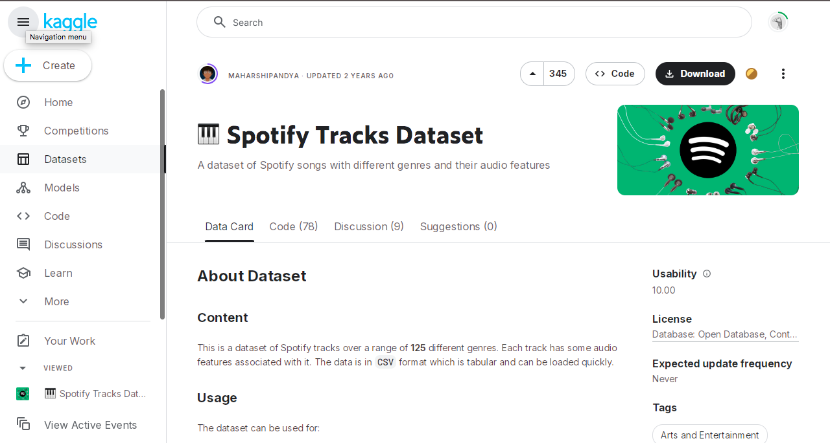
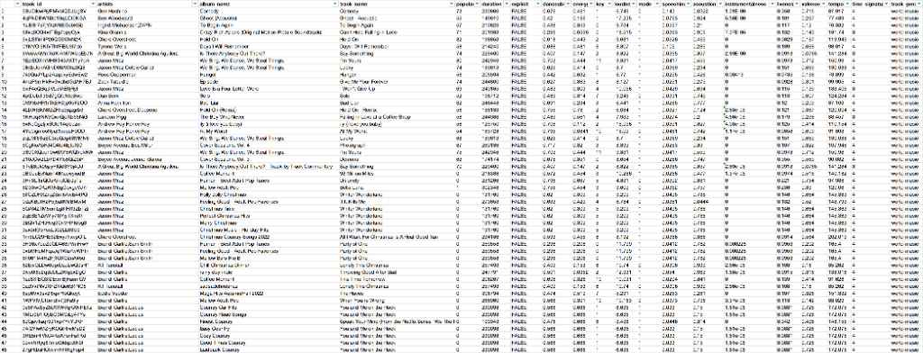
DATA SOURCE
The dataset used in this project was sourced from Kaggle, titled “Spotify Tracks Dataset”, which contains detailed information on tracks, artists, genres, and audio features. It represents a curated snapshot of Spotify’s music catalog, suitable for music trend analysis, artist performance evaluation, and feature-based recommendations.

Slide 10

DATA QUALITY
The dataset displays several quality concerns in its raw form. These include missing values in fields such as popularity and audio features, potential duplicate entries, and inconsistent text formats in columns like artist name and genre. Such issues may impact the reliability of analysis and require attention during the data preparation phase.

Slide 11
03
PROCESS

Slide 12

PROCESS
Defining Objectives
& Collecting Data
Data
Wrangling
Comparitive Data Analysis
Suggestions for Competitors
Set clear goals to analyze Spotify’s strategy using a Kaggle dataset of tracks and features.
Identified and prepared data by handling missing values, duplicates, and formatting issues.
Analyzed patterns in tracks, genres, and artists to understand Spotify’s market behavior.
Framed insights to help rivals optimize content and improve audience engagement.

Slide 13

CODE (PYTHON)
The language of python was used to complete one of the most crucial steps of this process - Data Wrangling. Significant libraries such as Pandas, MySQL Connector and so were used.
The QR Code attached here is of a jupyter notebook which has detailed steps to solve major problems such as handling missing data, duplicate values, pre-processing & exporting the processed data to MySQL.

Slide 14
04
ANALYSIS

Slide 15
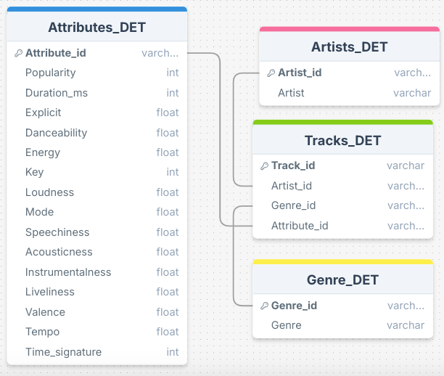
ENTITY RELATIONSHIP DIAGRAM
This ER diagram visually represents the normalized database schema for our Spotify competitor analysis. It showcases four key tables: Artists_DET, Genre_DET, Attributes_DET, and Tracks_DET. These tables are interconnected through foreign keys, enabling comprehensive analysis of artist performance, genre trends, and track attributes. This structured design is crucial for executing the advanced SQL queries that form the core of our competitive intelligence project.

Slide 16
Q1. Which genre has the highest average popularity across all tracks?
ANALYSIS - GENRE PERFORMANCE & TRENDS
SELECT G.Genre, AVG(AD.Popularity) AS Average_Popularity FROM Genre_DET G JOIN Tracks_DET T ON G.Genre_id = T.Genre_id JOIN Attributes_DET AD ON T.Attribute_id = AD.Attribute_id GROUP BY G.Genre ORDER BY Average_Popularity DESC LIMIT 1;

Slide 17
Q2. Which genre has the longest average track duration?
ANALYSIS - GENRE PERFORMANCE & TRENDS
SELECT G.Genre, AVG(AD.Duration_ms) AS Average_Duration FROM Genre_DET G JOIN Tracks_DET T ON G.Genre_id = T.Genre_id JOIN Attributes_DET AD ON T.Attribute_id = AD.Attribute_id GROUP BY G.Genre ORDER BY Average_Duration DESC LIMIT 1;

Slide 18
Q3.Detect genre fatigue: genres with declining average popularity over time
ANALYSIS - GENRE PERFORMANCE & TRENDS
SELECT G.Genre, STDDEV(AD.Energy) AS Energy_STD, STDDEV(AD.Tempo) AS Tempo_STD FROM Genre_DET G JOIN Tracks_DET T ON G.Genre_id = T.Genre_id JOIN Attributes_DET AD ON T.Attribute_id = AD.Attribute_id GROUP BY G.Genre ORDER BY Energy_STD DESC, Tempo_STD DESC;

Slide 19
Q4.Which artists consistently appear in the top 5 most popular tracks across genres?
ANALYSIS - ARTIST INFLUENCE & VISIBILITY
SELECT A.Artist, AVG(AD.Popularity) AS Average_Popularity FROM Artists_DET A JOIN Tracks_DET T ON A.Artist_id = T.Artist_id JOIN Attributes_DET AD ON T.Attribute_id = AD.Attribute_id GROUP BY A.Artist HAVING COUNT(T.Track_id) >= 5 ORDER BY Average_Popularity DESC;

Slide 20
Q5. List the artists who have contributed to the highest number of unique genres.
ANALYSIS - ARTIST INFLUENCE & VISIBILITY
SELECT A.Artist, COUNT(DISTINCT T.Genre_id) AS Number_of_Unique_Genres FROM Artists_DET A JOIN Tracks_DET T ON A.Artist_id = T.Artist_id GROUP BY A.Artist ORDER BY Number_of_Unique_Genres DESC;

Slide 21
Q5. Which artists have the highest average energy and danceability across their tracks?
ANALYSIS - ARTIST INFLUENCE & VISIBILITY
SELECT A.Artist, AVG(AD.Energy) AS Average_Energy, AVG(AD.Danceability) AS Average_Danceability FROM Artists_DET A JOIN Tracks_DET T ON A.Artist_id = T.Artist_id JOIN Attributes_DET AD ON T.Attribute_id = AD.Attribute_id GROUP BY A.Artist ORDER BY Average_Energy DESC, Average_Danceability DESC;

Slide 22
Q7. Which genre has the highest average valence and energy combined?
ANALYSIS - LISTNER ENGAGEMENT & INTERACTION
SELECT G.Genre, (AVG(AD.Valence) + AVG(AD.Energy)) AS Combined_Valence_Energy FROM Genre_DET G JOIN Tracks_DET T ON G.Genre_id = T.Genre_id JOIN Attributes_DET AD ON T.Attribute_id = AD.Attribute_id GROUP BY G.Genre ORDER BY Combined_Valence_Energy DESC LIMIT 1;

Slide 23
Q8. What is the average danceability score per genre, ranked from highest to lowest?
ANALYSIS - LISTNER ENGAGEMENT & INTERACTION
SELECT G.Genre, AVG(AD.Danceability) AS Average_Danceability FROM Genre_DET G JOIN Tracks_DET T ON G.Genre_id = T.Genre_id JOIN Attributes_DET AD ON T.Attribute_id = AD.Attribute_id GROUP BY G.Genre ORDER BY Average_Danceability DESC;

Slide 24
Q9.List the top 3 most popular tracks per genre (using DENSE_RANK).
ANALYSIS - TRACK LEVEL INSIGHTS
SELECT Genre, Track_Name, Popularity FROM (SELECT G.Genre, T.Track_Name, AD.Popularity, DENSE_RANK() OVER (PARTITION BY G.Genre ORDER BY AD.Popularity DESC) as drnk FROM Genre_DET G JOIN Tracks_DET T ON G.Genre_id = T.Genre_id JOIN Attributes_DET AD ON T.Attribute_id = AD.Attribute_id) AS RankedTracks WHERE drnk <= 3;

Slide 25
Q10. Which tracks are outliers in both tempo and energy (2 standard deviations from mean)?
ANALYSIS - TRACK LEVEL INSIGHTS
SELECT T.Track_Name, AD.Tempo, AD.Energy FROM Tracks_DET T JOIN Attributes_DET AD ON T.Attribute_id = AD.Attribute_id WHERE (AD.Tempo < (SELECT AVG(Tempo) - 2 * STDDEV(Tempo) FROM Attributes_DET) OR AD.Tempo > (SELECT AVG(Tempo) + 2 * STDDEV(Tempo) FROM Attributes_DET)) AND (AD.Energy < (SELECT AVG(Energy) - 2 * STDDEV(Energy) FROM Attributes_DET) OR AD.Energy > (SELECT AVG(Energy) + 2 * STDDEV(Energy) FROM Attributes_DET));

Slide 26
05
SUGGESTIONS

Slide 27
SUGGESTIONS
1
Add your words here,according to your need to draw the text box size.Please read the instructions and more work at the end of the manual template.
1
2
2
Add your words here,according to your need to draw the text box size.Please read the instructions and more work at the end of the manual template.
3
Add your words here,according to your need to draw the text box size.Please read the instructions and more work at the end of the manual template.
3
4
4
Add your words here,according to your need to draw the text box size.Please read the instructions and more work at the end of the manual template.
5
6
5
Add your words here,according to your need to draw the text box size.Please read the instructions and more work at the end of the manual template.
6
Add your words here,according to your need to draw the text box size.Please read the instructions and more work at the end of the manual template.

Slide 28
06
CONCLUSION

Slide 29
SUMMARY

Slide 30

THANK YOU
linkedin.com/in/
babitha-ravindra
github.com/
BabithaRavindra

